Slide 1
JAVA APPLET

Slide 2
CONTENTS
Introduction
Hierarchy
Working of the Lifecycle
Methods

Slide 3
INTRODUCTION
An applet is a Java program that runs in a Web browser.
Any applet in Java is a class that extends the java.applet.Applet class.
An applet is executed in some java interpreter programs such as
1. java technology-enabled browser
2. appletviewer
An applet uses AWT for graphics.
Applet begins with two importing statements.
An applet program can be executed in HTML page.

Slide 4
IMPORT STATEMENTS FOR APPLET:
To begin with applet, two statements required:
1. import java.applet.*;
This statement imports the applet package
2. import java.awt.*;
This statement imports the AWT package which supports for window based, Graphical User Interface

Slide 5
HIERARCHY OF APPLET
OBJECT
COMPONENT
CONTAINER
PANEL
APPLET

Slide 6
WORKING OF THE LIFECYCLE OF APPLET
INIT
START
DO SOME WORK
STOP
DESTROY

Slide 7
paint(Graphics g)
paint( ) is also called when the applet begins execution.
The paint( ) method has one parameter of type Graphics.
This parameter will contain the graphics context , which describes the graphics environment in which the applet is running.

Slide 8
Commonly used methods of Graphics class:
public abstract void drawString(String str, int x, int y): is used to draw the specified string.
public void drawRect(int x, int y, int width, int height): draws a rectangle with the specified width and height.
public abstract void fillRect(int x, int y, int width, int height): is used to fill rectangle with the default color and specified width and height.
public abstract void drawOval(int x, int y, int width, int height): is used to draw oval with the specified width and height.
public abstract void fillOval(int x, int y, int width, int height): is used to fill oval with the default color and specified width and height.
public abstract void drawLine(int x1, int y1, int x2, int y2): is used to draw line between the points(x1, y1) and (x2, y2).
public abstract void setColor(Color c): is used to set the graphics current color to the specified color.
public abstract void setFont(Font font): is used to set the graphics current font to the specified font.

Slide 9
GRAPHICS METHODS
Drawing shapes:
Syntax-
g.drawRect(100,60,100,60);
g.drawOval(150,50,150,50);
Draw String to an Applet:
Syntax-
g.drawstring(“JAVA APPLET”, 30,30)
Set colors to the shape:
Syntax-
g.setColor(Color.red);
Fill colors to the shapes:
Syntax-
g.fillRect(100,60,100,60);

Slide 10
Simple Applet Program:
import java.applet.*;
import java.awt.*;
public class SimpleApplet extends Applet
{
public void init()
{
System.out.println("INITIALISE");
}
public void start()
{
System.out.println("WELCOME TO JAVA APPLET");
}

Slide 11
public void paint(Graphics g)
{
Font f;
f=new Font("Arial",Font.BOLD,12);
g.setFont(f);
g.drawString("JAVA APPLET", 220, 50);
g.drawRect(170, 60,170 , 60);
g.setColor(Color.red);
g.fillRect(170, 60, 170, 60);
g.drawOval(169,60, 169, 60);
g.setColor(Color.green);
g.fillOval(169, 60, 169, 60);
g.drawRoundRect(350, 65, 80, 50, 65, 30);
g.setColor(Color.green);
g.fillRoundRect(350, 65, 80, 50, 65, 30);

Slide 12
g.drawRoundRect(75, 65, 80, 50, 65, 30);
g.setColor(Color.green);
g.fillRoundRect(75, 65, 80, 50, 65, 30);
g.setColor(Color.black);
g.drawLine(150, 170, 355, 170);
}
public void stop()
{
System.out.println("STOP THE CODE");
}
public void destroy()
{
System.out.println("DESTROY THE CODE");
}
}

Slide 13
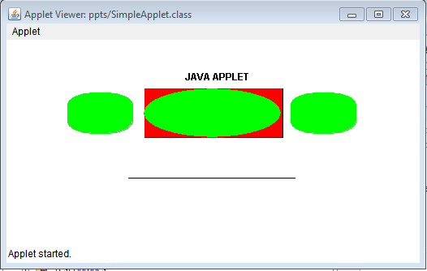
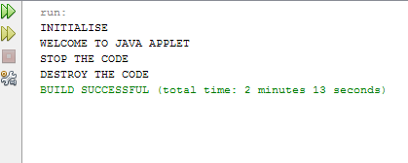
OUTPUT:

Slide 14


